Slide 1
Industrial Training
Name – Vansh Sharma
Branch – IT / C
Company – Groot Software
Project – Attendance System
Duration – 45 Days

Slide 2
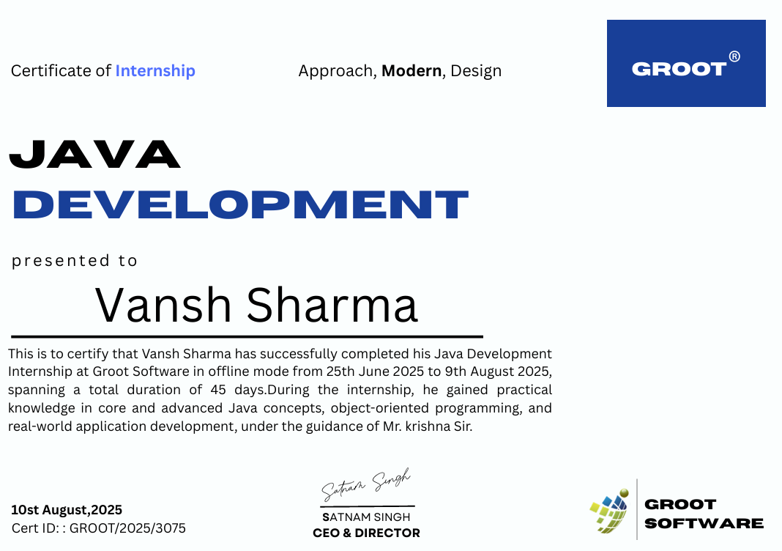
Certificate

Slide 3
Objectives of the Training
Skill Development – To enhance technical proficiency and professional expertise in full-stack Java development, encompassing both back-end logic and front-end GUI design.
Practical Exposure – To bridge the gap between academic knowledge and real-world application by successfully designing, developing, and deploying the Smart Attendance System project.
Core Competence – To solidify knowledge in core and advanced Java concepts, object-oriented programming (OOP) principles, and Relational Database Management (MySQL).
Problem-Solving Ability – To train in identifying, analyzing, and solving complex technical challenges, specifically integrating disparate technologies like Java Swing, ESP32, and NFC.
Adaptability & Integration – To prepare for handling new tools and technologies by mastering hardware-software integration to create a seamless, automated login/logout system.
Productivity Improvement – To increase efficiency and accuracy in data management by implementing an automated system that replaces manual record-keeping with NFC-based logging.
Innovation & Creativity – To encourage new ideas by developing a novel desktop GUI application in Java Swing that displays real-time attendance records sourced from physical NFC scans.

Slide 4
Project Description
The project is a Smart Attendance System developed using Java (Swing GUI), MySQL for data persistence, and ESP32 integrated with NFC technology.
It allows for:
Automated Logging: Scans NFC tags to automatically record users' login and logout times.
Database Management: Utilizes MySQL to store and manage attendance records and user data securely.
Desktop Interface: Features a dedicated Java Swing Desktop GUI for easy record retrieval, display, and administrative management.
The system demonstrates hardware-software integration, using the ESP32 to communicate with the NFC reader and backend. The Java application retrieves this real-time data to display and manage attendance logs, ensuring high efficiency and eliminating manual entry errors.
The project demonstrates how core Java concepts and IoT principles can be combined to create a practical, real-world application for time and attendance tracking.

Slide 5
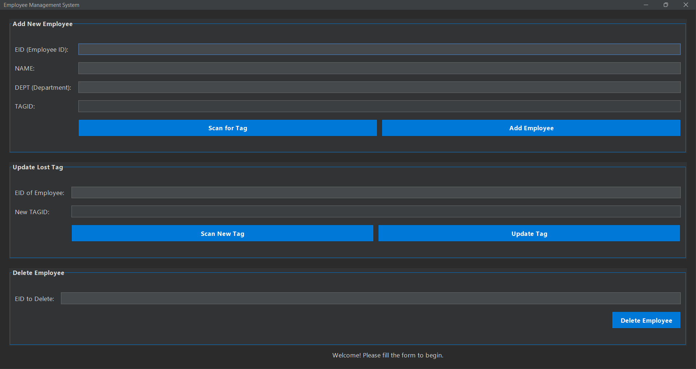
Project Interface
Employee Management and tagging Interface :-

Slide 6
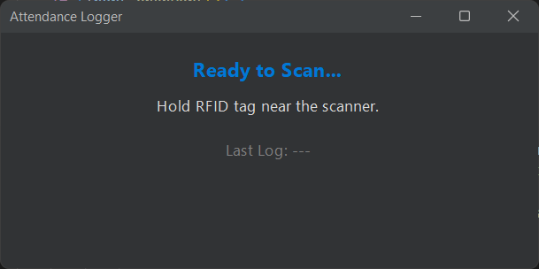
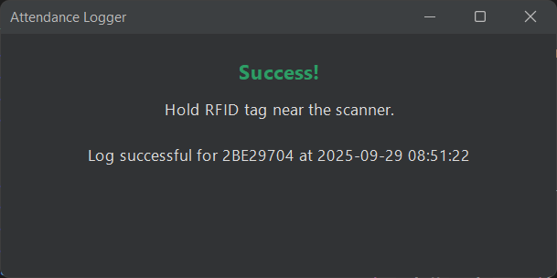
Project Interface
Logging Interface :-

Slide 7
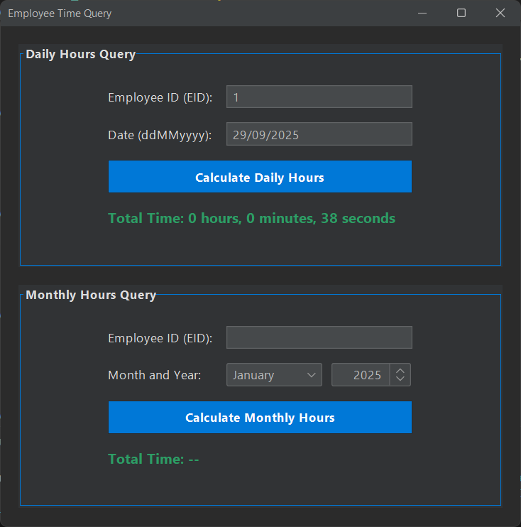
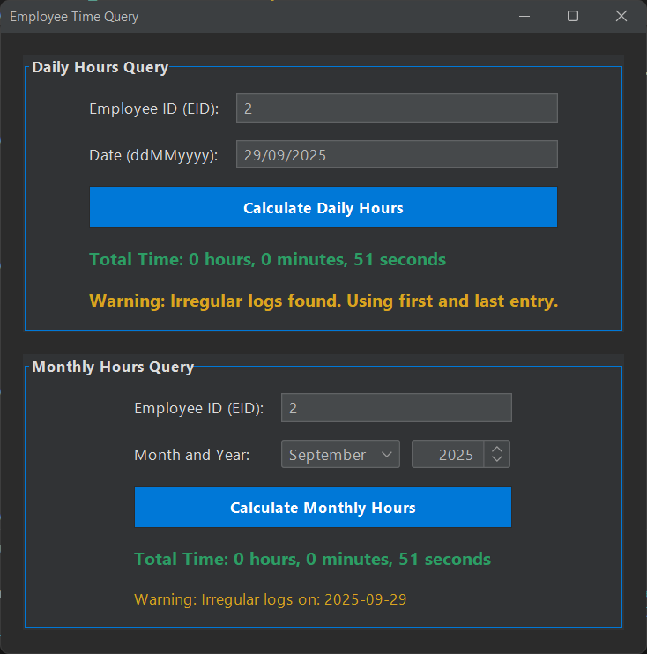
Project Interface
Time Query Interface :-

Slide 8
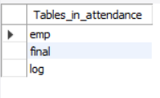

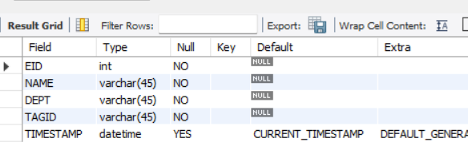
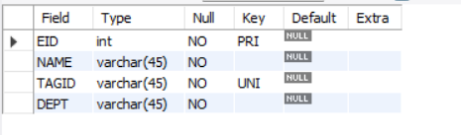
Database Structure
use attendance;
show tables;
DESC log;
DESC final;
DESC emp;

Slide 9
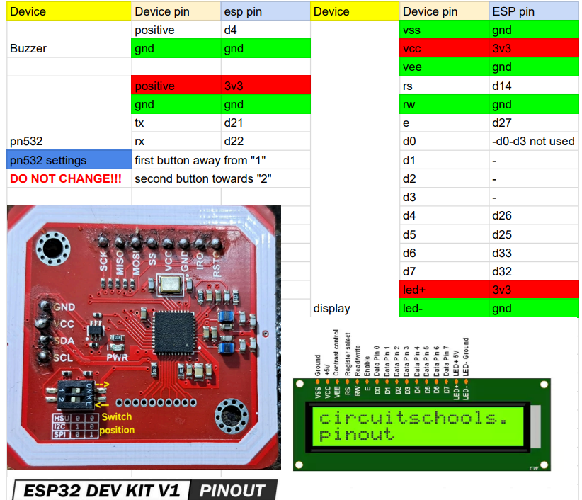
Hardware Part

Slide 10
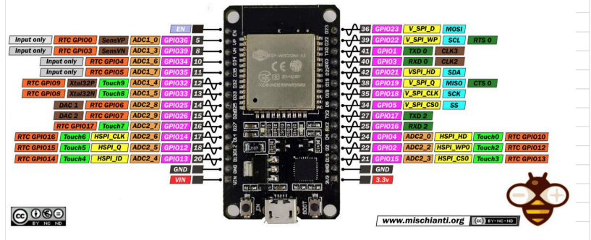
Hardware Part

Slide 11
Hardware Part

Slide 12
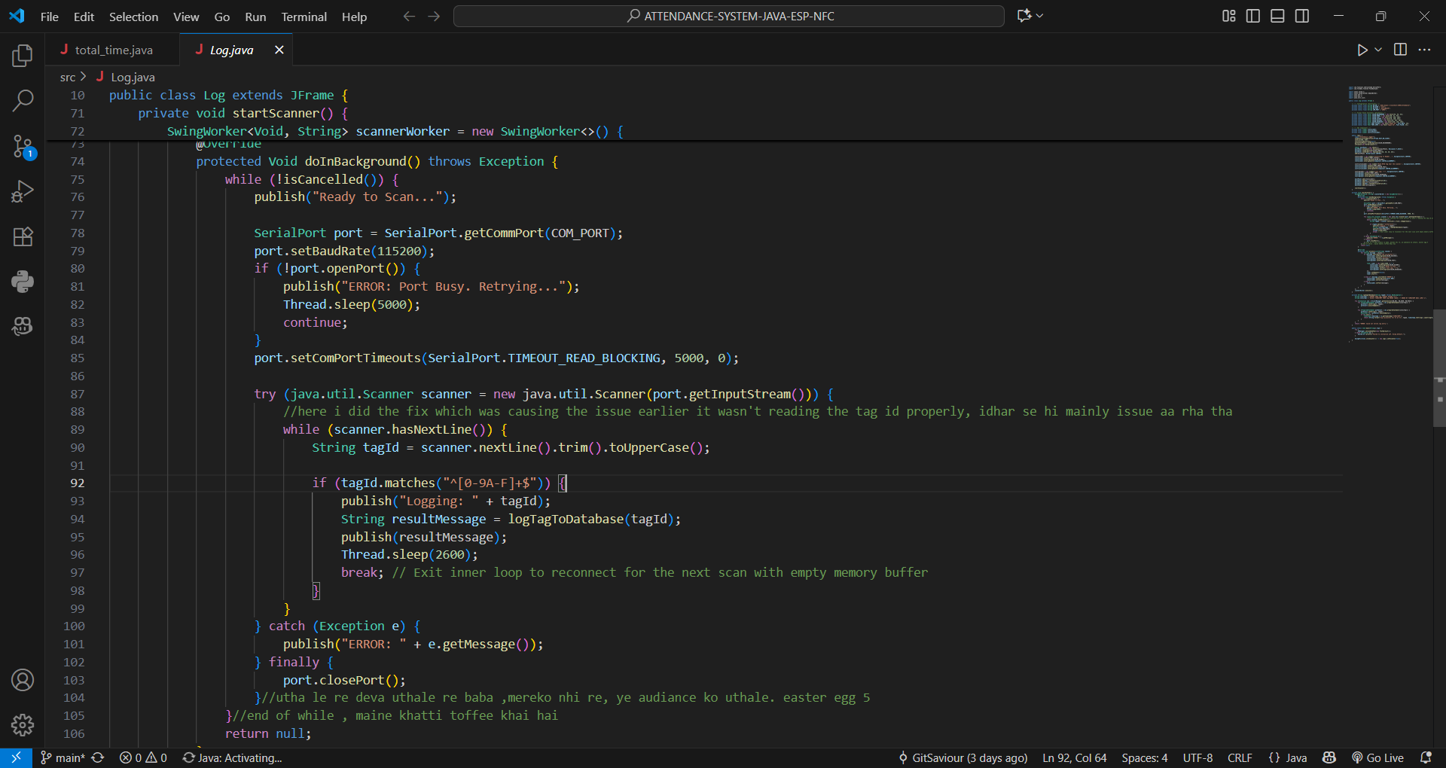
Project Code

Slide 13
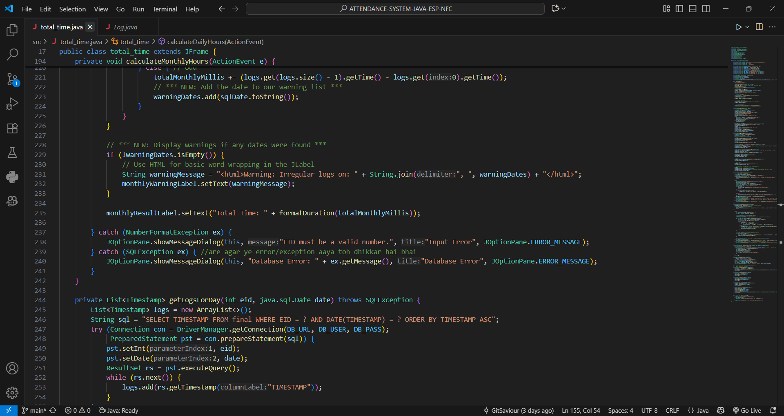
Project Code

Slide 14
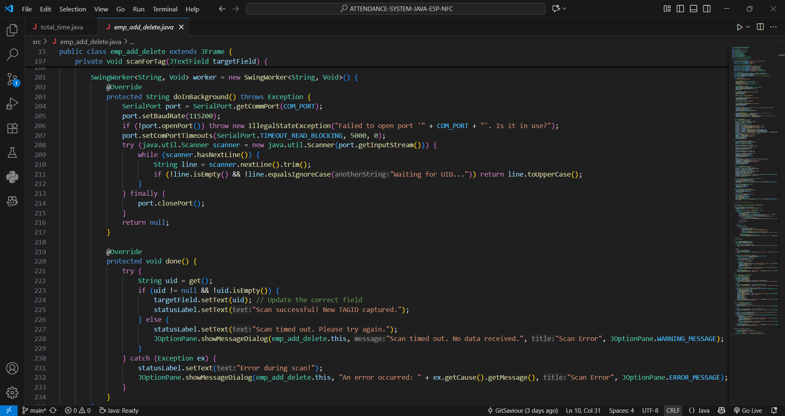
Project Code

Slide 15
Technologies/Tools Used
Frontend Interface: Java Swing for building the Desktop GUI with a focus on administrative display, data visualization, and user interaction.
Backend Logic: Core Java (OOP principles) for implementing all business logic, data processing, and handling communication between the database and the hardware.
Programming Language: Java for robust, cross-platform application development, focusing on stability and performance.
Database: MySQL for storing and managing attendance logs, user data, and login/logout times securely.
IoT/Hardware Integration: ESP32 Microcontroller and NFC Reader for capturing real-time physical attendance events and transmitting data.
Development Environment: IntelliJ IDEA/Eclipse — integrated development environments (IDEs) used for efficient Java code development, debugging, and project structure management.
Version Control: Git & GitHub for tracking code changes, managing repository history, and handling collaborative development (if applicable).
Support Tools: MySQL Workbench for database design, querying, and management; documentation and community forums for ESP32/NFC communication protocols.

Slide 16
Key Tasks & Responsibilities
The primary tasks involved designing, developing, and integrating software and hardware components to deliver a functional, automated attendance system.
GUI Development (Java Swing): Designed and implemented the complete Desktop Graphical User
Interface (GUI) for administrators to view, filter, and manage attendance logs and user data.
Backend & Business Logic: Developed core Java classes and applied Object-Oriented Programming (OOP) principles to handle data processing, manage user sessions, and execute application logic.
Database Design & Management: Created the MySQL database schema, including tables for users, attendance records (login/logout times), and managed all CRUD operations via the Java application.
API/Service Integration: Established and managed the connection between the Java application and the MySQL database to ensure secure and persistent data storage.

Slide 17
Hardware-Software Interfacing: Configured the ESP32 microcontroller to read data from the NFC reader and successfully established the data transmission protocol (e.g., via TCP/IP or serial) to communicate with the Java backend.
Real-Time Data Handling: Implemented logic to process real-time input from the NFC reader, accurately timestamp and log attendance events, and update the GUI display immediately.
Testing & Debugging: Performed unit and integration testing across all layers (hardware, database, and GUI) to ensure system reliability, security, and accurate attendance tracking.

Slide 18
Challenges Faced & Solutions
The development process involved overcoming significant challenges, particularly in integrating hardware components with the software application and managing real-time data persistence.
Hardware-Software Communication: Faced issues in establishing a reliable, persistent connection between the ESP32 Microcontroller (NFC reader) and the Java backend.
Solution: Implemented a secure TCP/IP socket connection or serial communication protocol to ensure stable data transmission from the ESP32 to the Java application's service layer.
Real-Time Data Synchronization: Ensuring the Java Swing GUI displayed the latest attendance logs instantly upon an NFC tag scan was challenging.
Solution: Implemented efficient database polling or a data listener pattern within the Java application to automatically fetch and update the GUI components immediately after a new record was saved to MySQL.
Data Consistency & Schema Design: Needed a precise way to capture and store two distinct events (login and logout) accurately for the same user based on subsequent NFC scans.
Solution: Designed a robust MySQL database schema with flags or logic to track the current status of a user (checked-in/checked-out) and accurately record the corresponding timestamp for each event.
Preventing Input Errors (GUI): Potential for errors in manual data entry or display formatting within the administrative Java Swing GUI.
Solution: Applied input validation logic and robust error handling in Java to prevent bad data from reaching the database, and utilized appropriate Swing layout managers for a fixed, clean display.

Slide 19
Learning Outcomes
The project provided extensive practical experience in integrating software and hardware, mastering core Java principles, and managing data in a real-world, automated system.
Gained hands-on experience in cross-platform desktop application development using Java (Swing) for creating a functional and user-friendly GUI.
Learned how to design and implement robust service layers in Java for handling business logic and ensuring reliable application performance.
Mastered data persistence and management by designing, implementing, and querying a MySQL database to store structured attendance records efficiently.
Improved skills in Object-Oriented Programming (OOP), focusing on concepts like inheritance, encapsulation, and modularity for building maintainable Java code.
Practiced full-cycle hardware-software integration, successfully connecting and managing data transmission from an ESP32 microcontroller and NFC reader to the Java backend.
Developed knowledge of real-time data handling and synchronization techniques to instantly update the GUI based on events triggered by the NFC hardware.

Slide 20
Achievements
Successfully developed a Smart Attendance System integrating a Desktop GUI with a custom-built hardware solution (ESP32/NFC).Built an Admin Panel that allows real-time add, update, and delete operations for menu items.
Built a robust Java Swing Desktop Application that provides administrative oversight, allowing for easy retrieval and display of attendance records. Ensured mobile responsiveness and smooth user experience across different devices.
Implemented secure data persistence using MySQL, reliably storing real-time login and logout timestamps for all users . Applied best practices in version control with Git and GitHub for structured project management.
Achieved seamless hardware-software integration, successfully establishing a communication protocol between the ESP32 Microcontroller and the Java backend service layer.
Automated the entire attendance process, creating a system that ensures high accuracy and eliminates manual entry errors through the use of NFC technology.
Applied best practices in Version Control with Git and GitHub for structured code management and project iteration.

Slide 21
Conclusion & Future Recommendations
Conclusion
The Smart Attendance System project successfully demonstrated the use of core Java concepts, Desktop GUI development, and IoT integration to build a functional and highly efficient real-world application. The project highlighted the importance of a robust backend in Java for processing logic, MySQL for secure data persistence, and hardware interfacing (ESP32/NFC) for automated, accurate data capture. Overall, it showcases how desktop applications can be combined with modern hardware to solve real-world problems in time and attendance tracking.
Future Recommendations
Network Deployment: Host the MySQL database on a central server and configure the Java application for client access to support large-scale deployment across a corporate or campus network.
Biometric/Face Recognition Integration: Enhance security and authentication options by integrating additional hardware for biometric or facial recognition capabilities.
Web/Mobile Interface: Develop a lightweight web or mobile interface (e.g., using a modern Java framework like Spring Boot for the backend) for management to view reports remotely.
Reporting & Analytics: Implement advanced reporting features within the Java GUI (e.g., charts and graphs) to analyze attendance trends and visualize labor hours.
Push Notifications/Alerts: Integrate a mechanism (e.g., email or SMS) to notify supervisors automatically of user check-in/check-out events or potential attendance anomalies.

Slide 22
Thank You
“I appreciate your time and attention.”
“I am happy to answer any questions you may have regarding my project.”

